Slide 1
Targets for the day
The Central Limit Theorem, and empirical demonstration of
The Standard Error
Hypothesis testing
Confidence intervals
Interpreting p-values and confidence intervals

Slide 2
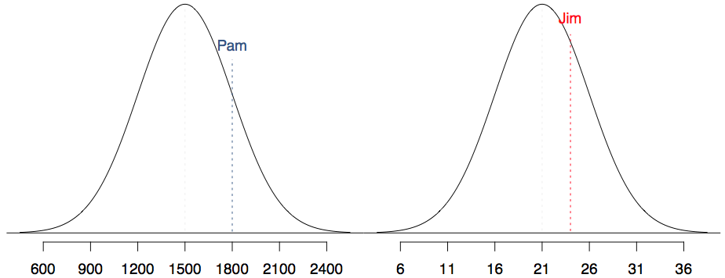
SAT scores are distributed nearly normally with mean 1500 and standard deviation 300. ACT scores are distributed nearly normally with mean 21 and standard deviation 5. A college admissions officer wants to determine which of the two applicants scored better on their standardized test with respect to the other test takers: Pam, who earned an 1800 on her SAT, or Jim, who scored a 24 on his ACT?

Slide 3
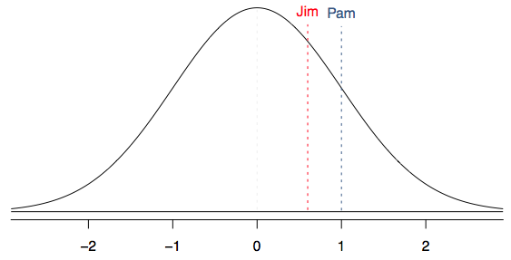
Standardizing with Z scores
Since we cannot just compare these two raw scores, we instead compare how many standard deviations beyond the mean each observation is.
Pam's score is (1800 - 1500) / 300 = 1 standard deviation above the mean.
Jim's score is (24 - 21) / 5 = 0.6 standard deviations above the mean.

Slide 4
To our rescue: The Central Limit Theorem
For our purpose, the CLT states that the distribution of averages of iid variables (properly normalized) becomes that of a standard normal, as the sample size increases.

Slide 5
Empirical demonstration: The Central Limit Theorem
Notes:
> library(openintro)
> library(tidyverse)
> data('yrbss')
> pop_mean <- mean(yrbss$physically_active_7d, na.rm = T)
> pop_sd <- sd(yrbss$physically_active_7d, na.rm = T)
> samp_params <- yrbss %>% rep_sample_n(size = 100, reps = 15000, replace = T) %>% summarise(avgactivity = mean(physically_active_7d, na.rm = T), sigma = sd(physically_active_7d, na.rm = T))
> mean(sampmeans$avgactivity)
> ggplot(data = sampmeans, aes(x = avgactivity)) + geom_histogram()
> sd(samp_params$avgactivity)
> pop_sd/sqrt(100)

Slide 6
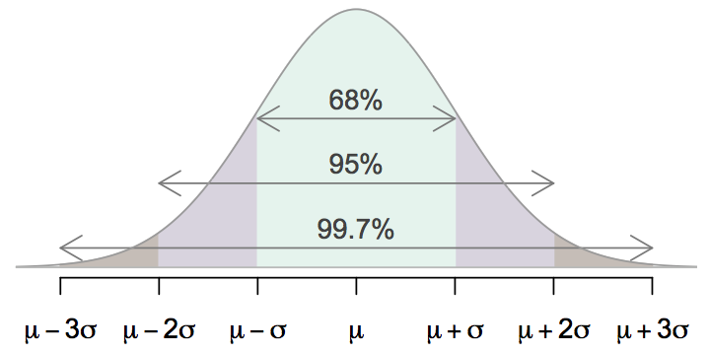
68-95-99.7 Rule
For nearly normally distributed data,
about 68% falls within 1 SD of the mean,
about 95% falls within 2 SD of the mean,
about 99.7% falls within 3 SD of the mean.
It is possible for observations to fall 4, 5, or more standard deviations away from the mean, but these occurrences are very rare if the data are nearly normal.

Slide 7
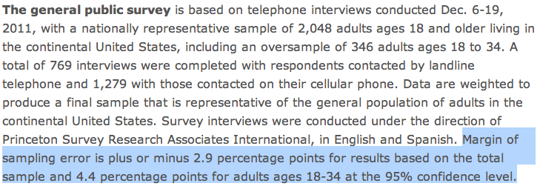
Margin of error
41% ± 2.9%: We are 95% confident that 38.1% to 43.9% of the public believe young adults, rather than middle-aged or older adults, are having the toughest time in today's economy.
49% ± 4.4%: We are 95% confident that 44.6% to 53.4% of 18-34 years olds have taken a job they didn't want just to pay the bills.

Slide 8
Confidence intervals
Confidence interval, a general formula
point estimate ± z* x SE
Conditions when the point estimate = x̄
Independence: Observations in the sample must be independent
random sample/assignment
if sampling without replacement, n < 10% of population
Sample size / skew: n ≥ 30 and population distribution should not be extremely skewed

Slide 9
Changing the confidence level
point estimate ± z* x SE
In a confidence interval, z* x SE is called the margin of error, and for a given sample, the margin of error changes as the confidence level changes.
In order to change the confidence level we need to adjust z* in the above formula.
Commonly used confidence levels in practice are 90%, 95%, 98%, and 99%.
For a 95% confidence interval, z* = 1.96.
However, using the standard normal (z) distribution, it is possible to find the appropriate z* for any confidence level.

Slide 10
Hands on the keyboards
Load the data set mtcars in the datasets R package. Calculate a 95% confidence interval to the nearest MPG for the variable mpg.
Notes:
data("mtcars")
xbar <- mean(mtcars$mpg)
xbar + c(-1,1) * qnorm(0.975) * (sd(mtcars$mpg)/sqrt(nrow(mtcars)))

Slide 11
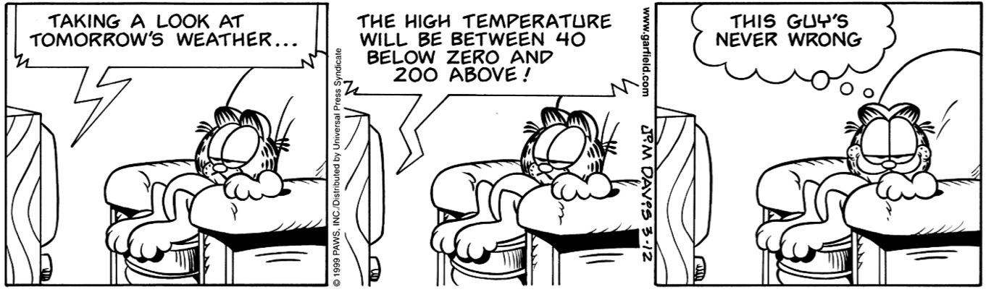
Width of an interval
If we want to be more certain that we capture the population parameter, i.e. increase our confidence level, should we use a wider interval or a smaller interval?
A wider interval.
Can you see any drawbacks to using a wider interval?
If the interval is too wide it may not be very informative.
Image source: http://web.as.uky.edu/statistics/users/earo227/misc/garfield_weather.gif

Slide 12
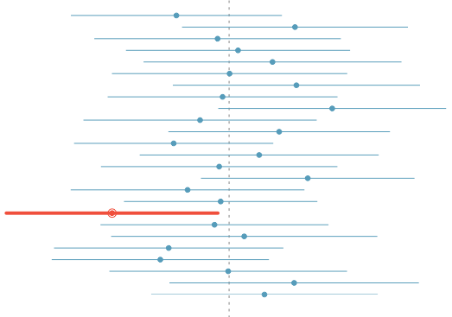
What does 95% confident mean?
Suppose we took many samples and built a confidence interval from each sample using the equation point estimate ± 2 x SE.
Then about 95% of those intervals would contain the true population mean (µ).
The figure shows this process with 25 samples, where 24 of the resulting confidence intervals contain the true average number of exclusive relationships, and one does not.

Slide 13
Practice
Which of the below Z scores is the appropriate z* when calculating a 98% confidence interval?
(a) Z = 2.05
(b) Z = 1.96
(c) Z = 2.33
(d) Z = -2.33
(e) Z = -1.65

Slide 14
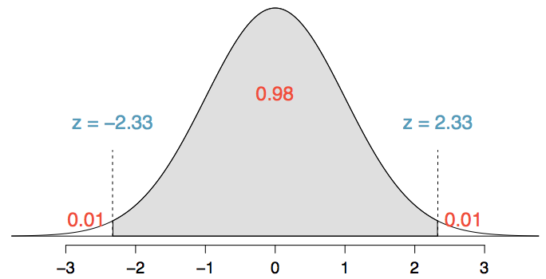
Practice
Which of the below Z scores is the appropriate z* when calculating a 98% confidence interval?
(a) Z = 2.05
(b) Z = 1.96
(c) Z = 2.33
(d) Z = -2.33
(e) Z = -1.65

Slide 15
Hands on the keyboards
Give a confidence interval for the average height of sons in Galton’s data.
Notes:
> library(UsingR)
> data(father.son)
> xbar <- father.son$sheight
> xbar + c(-1, 1) * qnorm(0.975) * sd(father.son$sheight)/sqrt(nrow(father.son))

Slide 16
Discussion
Consider a court of law; the null hypothesis is that the defendant is innocent
We require a standard on the available evidence to reject the null hypothesis (convict)
If we set a low standard, then we would increase the percentage of innocent people convicted (type I errors); however we would also increase the percentage of guilty people convicted (correctly rejecting the null)
If we set a high standard, then we increase the percentage of innocent people let free (correctly accepting the null) while we would also increase the percentage of guilty people let free (type II errors)

Slide 17
Hypothesis testing
The alternative hypotheses are typically of the form <, > or !=
Note that there are four possible outcomes of our statistical decision process
TRUTH | DECIDE | RESULT
H0 | H0 | Correctly accepted null
H0 | Ha | Type I error
Ha | Ha | Correctly rejected null
Ha | H0 | Type II error

